Slide 1
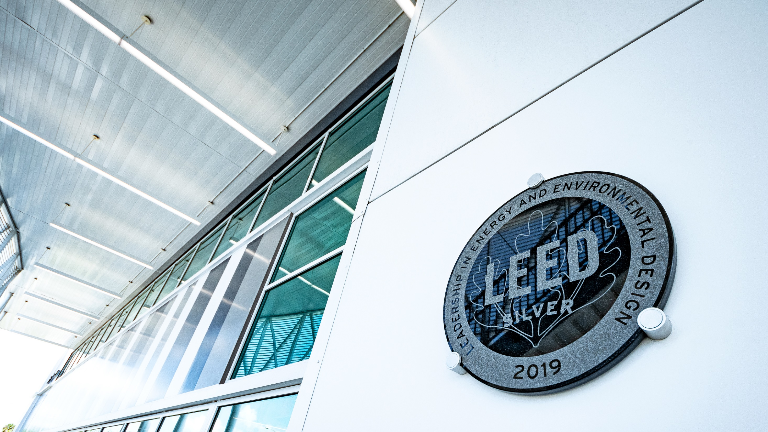
JTA Sustainability Initiatives
Alexander Traversa
Sustainability Program Manager
Planning & System Development

Slide 2
AGENDA
1. About JTA
2. Sustainability at JTA
3. Sustainable Transportation
4. Sustainability Action Plan
5. Emerging Trends

Slide 3
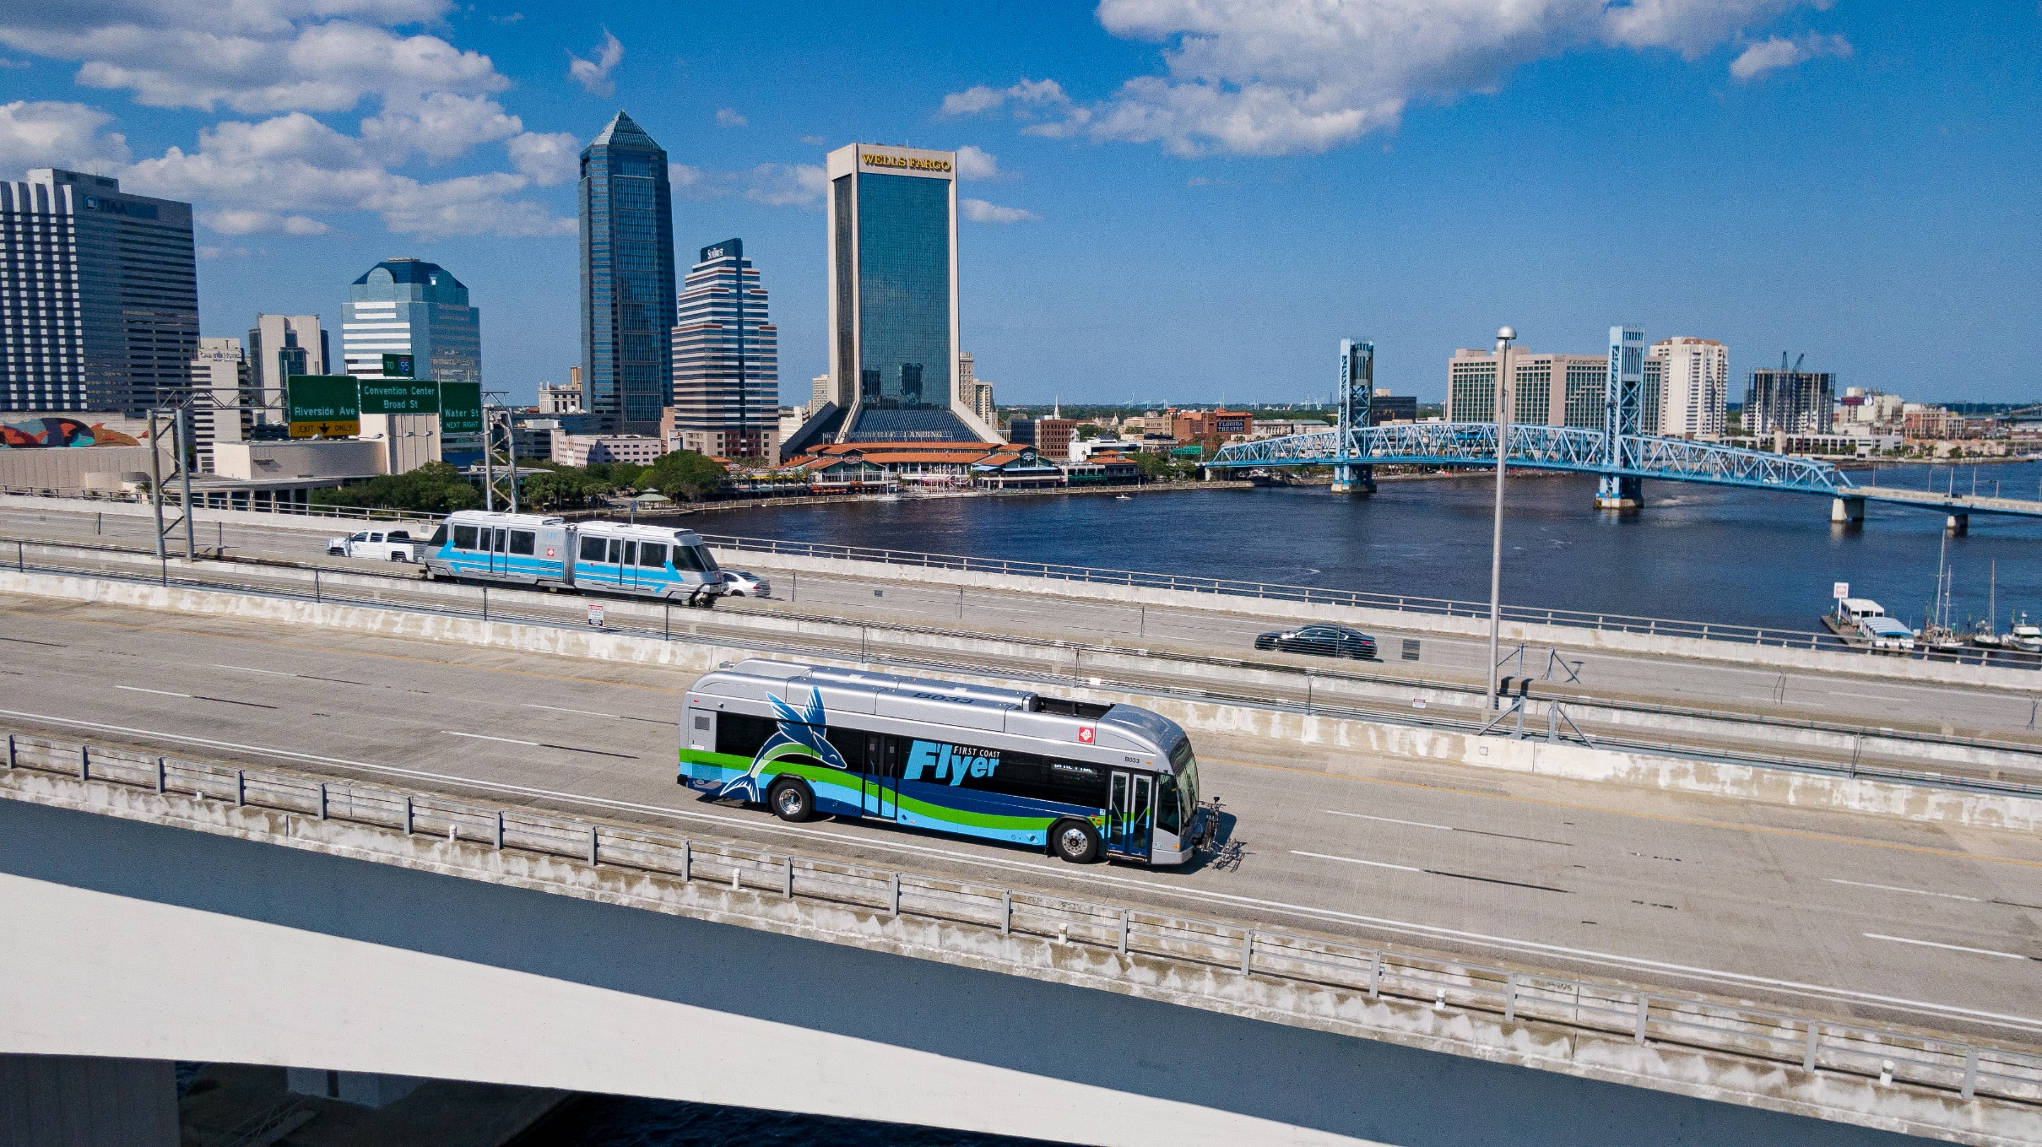
About JTA
769 Employees
Multimodal Mass Transit Provider
Service Area: 1383 mi²
Mid-sized Public Transit System
230 Buses
Skyway (APM)
Ferry
Readi-Ride (DR)
Paratransit
Design and Construction

Slide 4
Organizational Priority
Mission Statement
To improve Northeast Florida’s economy, environment and quality of life by providing safe, reliable, efficient and sustainable multimodal transportation services and facilities.
JTA Goals
Financial Sustainability
Ensure long-term financial sustainability
Sustainability
Advance transportation solutions that support environmental goals and are mindful of the context of our community

Slide 5
Organizational Structure
Greer Johnson Gillis, P.E.
Vice President - System Development
Alexander Traversa
Sustainability Program Manager
Sustainability Committee

Slide 6
Challenges
Lack of employee commitment /enthusiasm
Perception of performance
Perception of costs
Lack of knowledge
Conflicting priorities
Not an organizational priority
Lack of senior management commitment
Financial constraints

Slide 7
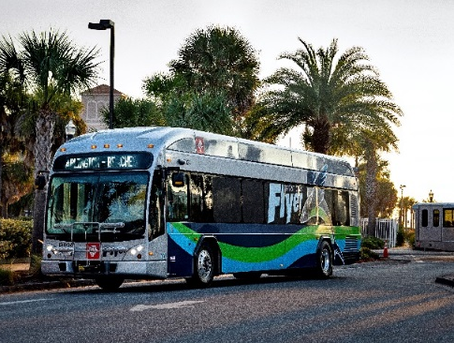
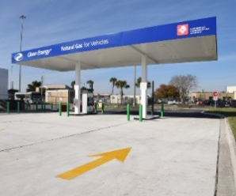
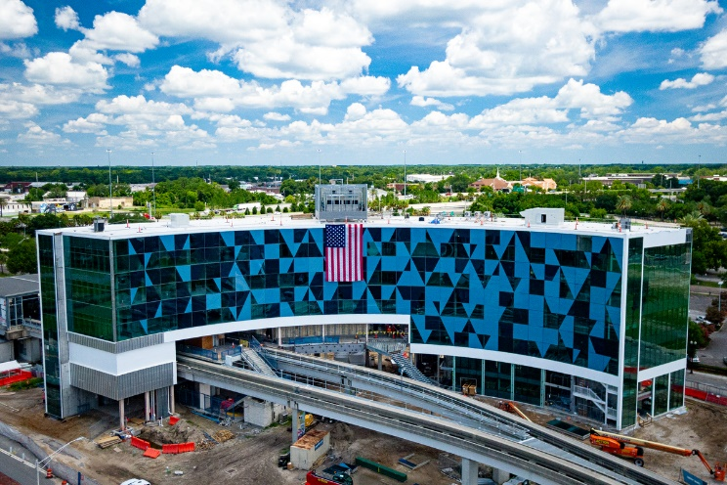
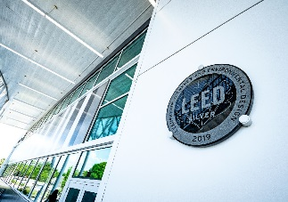
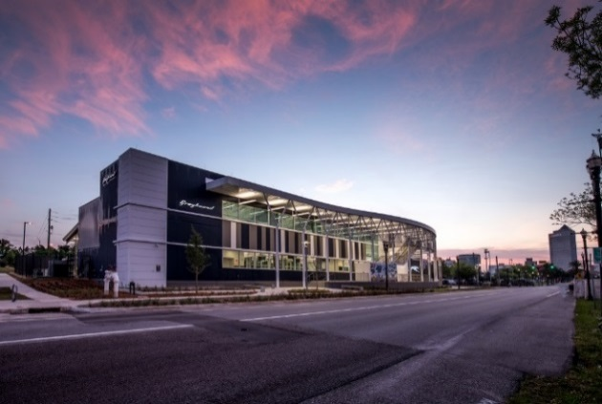
Sustainable Achievements
JTA Commits to APTA Sustainability Commitment
First Coast Flyer Launches Using CNG Buses
Sustainability KPI Added to Agency-wide Monthly Metrics
JTA Sustainability Champion Selected and Committee Formed
Implemented LED Lighting Standards
Myrtle Campus LED Lighting Retrofit
IBT Construction and LEED Silver Certification
Construction of Jacksonville Regional Transportation Center at LaVilla
CNG Fueling Station Constructed
Sustainability Incorporated into Authority Mission and Vision Statements
Sustainability Action Plan
Sustainability Goals

Slide 8
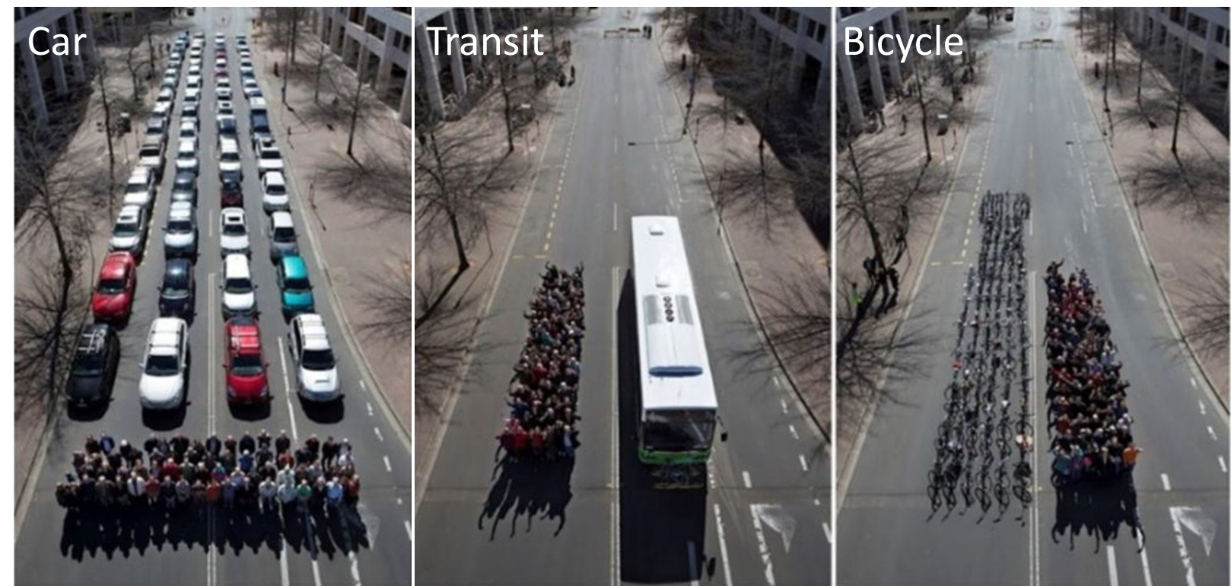
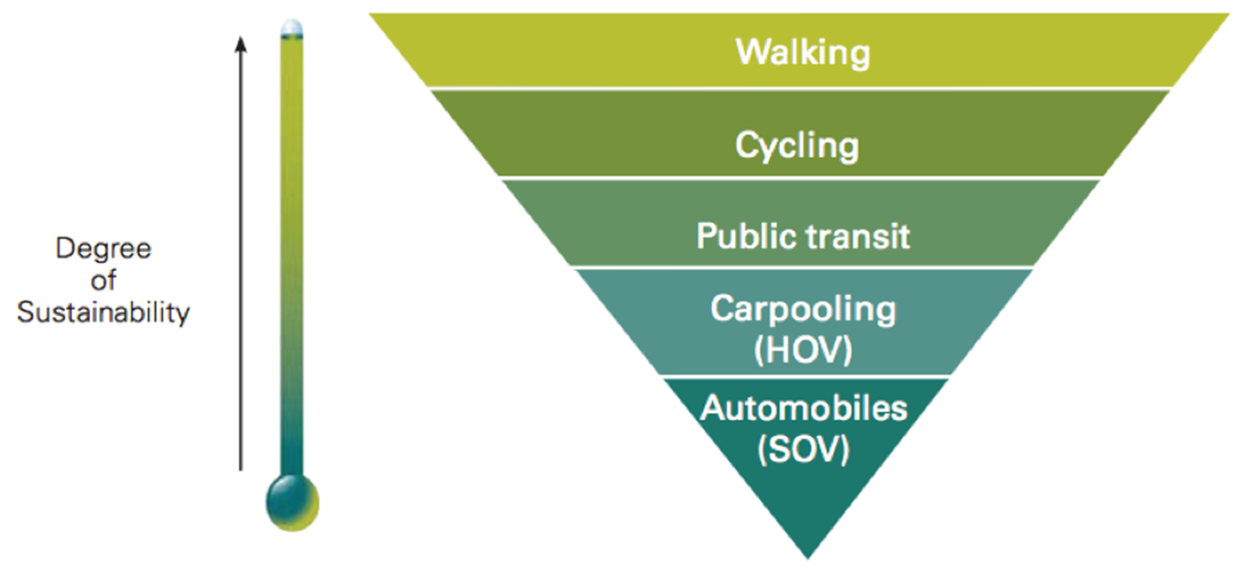
Importance of Sustainability in Transportation
Highest contributing GHG Sector in U.S.
28% of all GHG Emissions
2nd Highest Household Expense
16% spent on travel related expenses
Time Spent Traveling
Average of over an hour per day
Increasing congestion
Decline in Public Health and Quality of Life
Criteria Air Pollutant Emissions
Safety

Slide 9
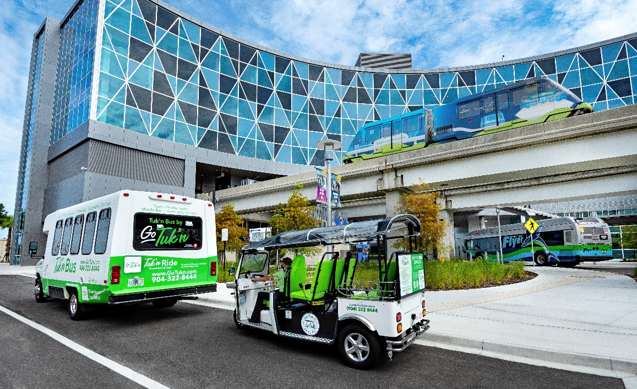
Improving Services
Increase Operational Efficiency
Leveraging data to understand use and improve service
Multimodality
Services designed to serve specific functions
Improved Accessibility, Frequency, Reliability, and Convenience
First and Last Mile connections
Understand the Quality of Life Impact
Improving equity and opportunity

Slide 10
Vehicles and Fuel
Compressed Natural Gas (CNG)
100% Bus Rapid Transit (BRT) Fleet
60% of total fleet
Publically accessible fueling station
Electricity
Skyway
Automated Vehicles
EV Bus Pilot
Readi-Ride / Express Selects
Smaller vehicles
Serve a specific service model

Slide 11
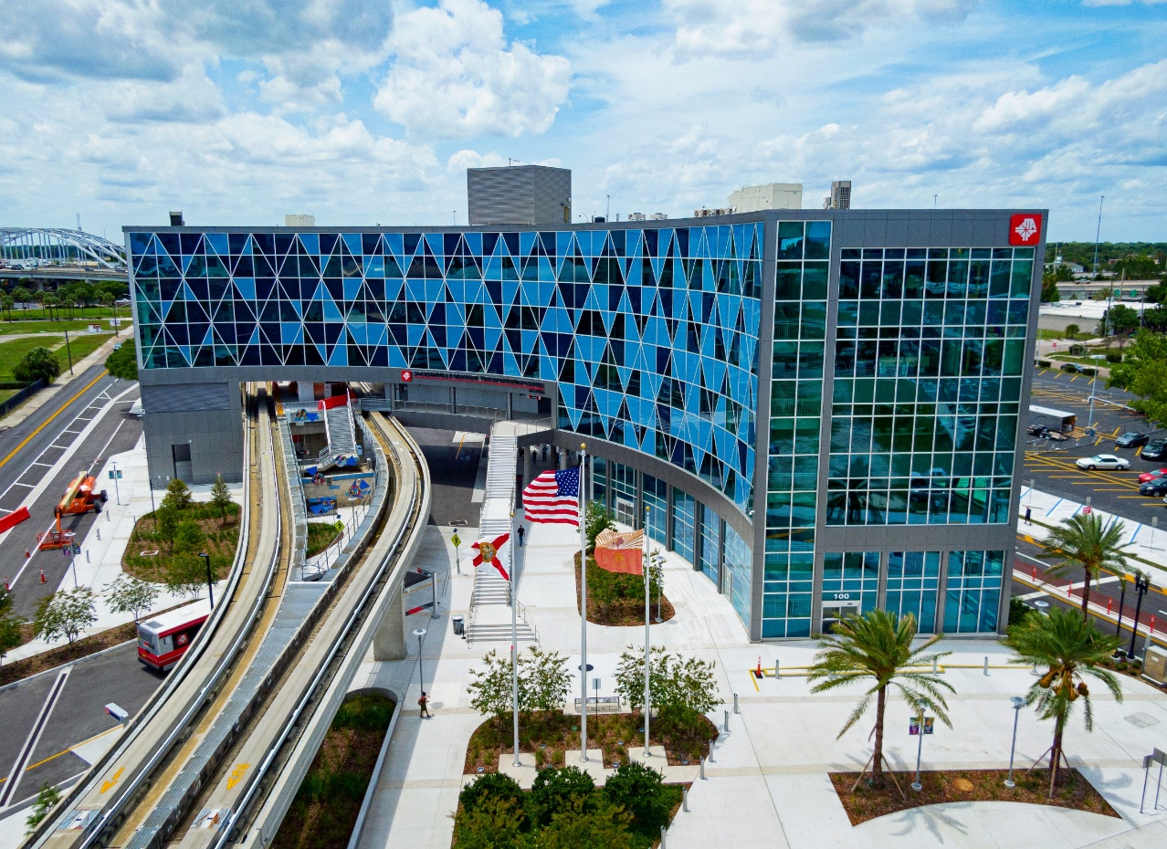
Facilities
LEED Certified Transit Facilities
JRTC – Awaiting Gold
IBT – Certified Silver
BMP’s for Facility Design
LED Standards
Solar Program
Amenities
Solar Lights at Shelters and Stops
ADA Accessibility

Slide 12
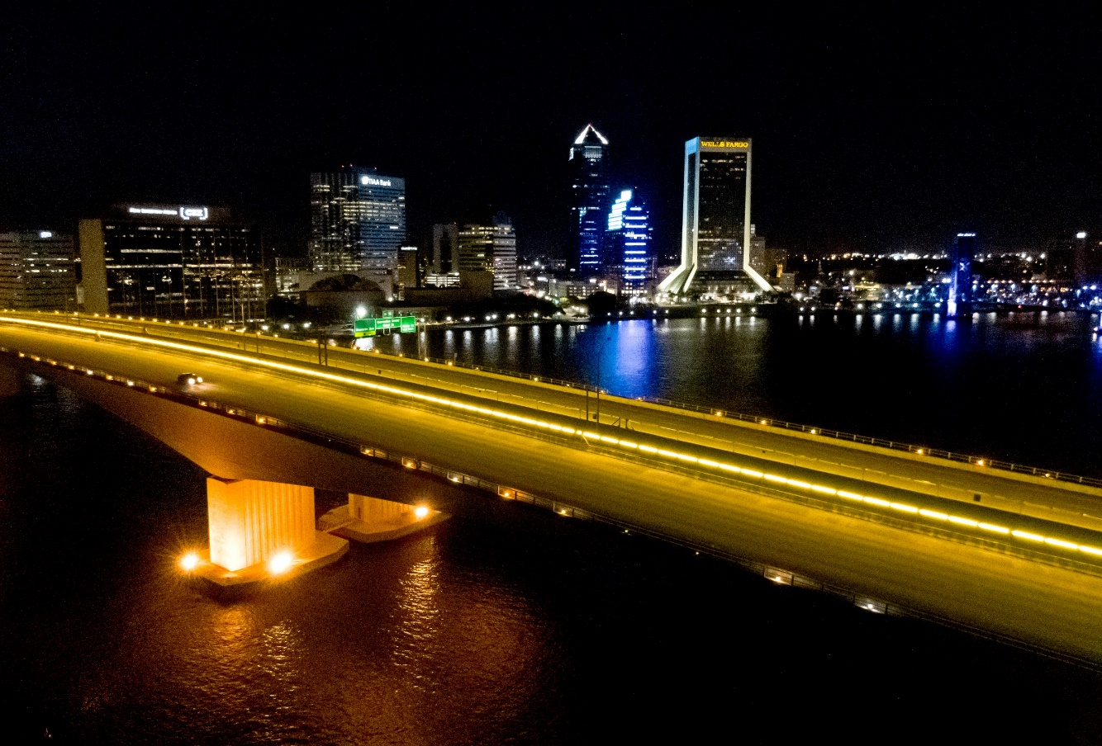
Capital Projects
Waste Diversion
>90% on recent projects
Sustainable Design Features
LED Standards
Pollutant Control
Optimize Efficiency
Community Benefits
Accessibility
Safety
Quality of Life

Slide 13
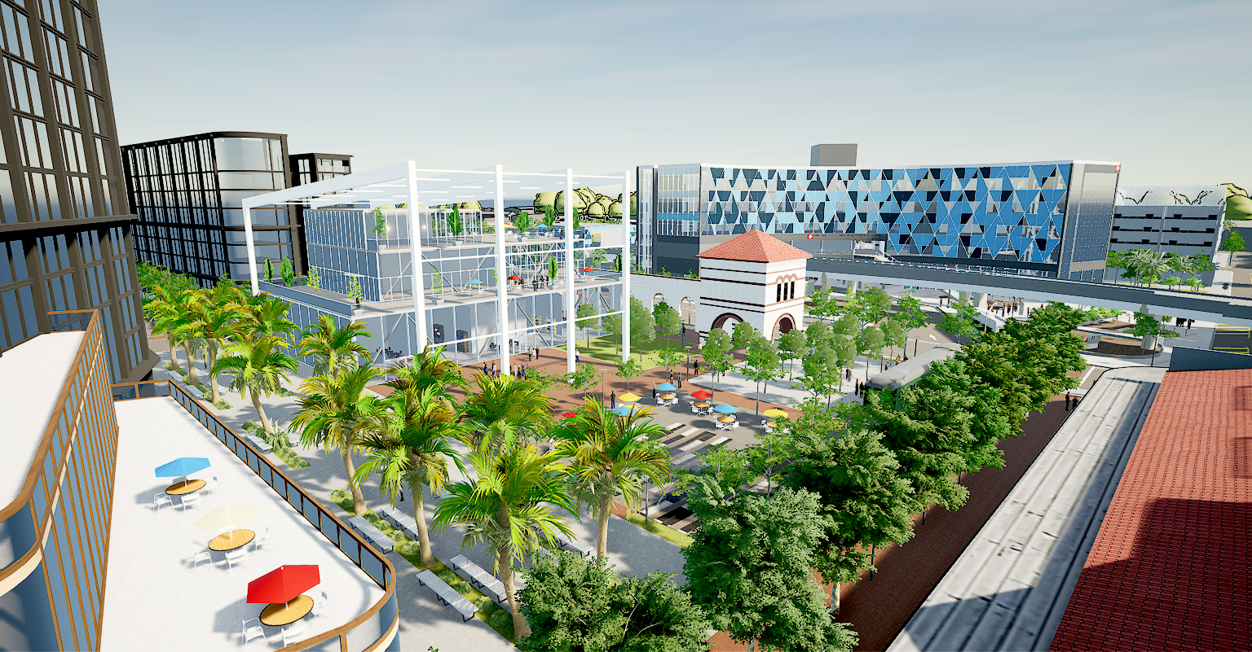
Transportation & Land Use
Transit Oriented Development
Sustainable development pattern
Anchored by high quality transit
Reduce the need for personal automobile and VMT
Supports active modes of transportation
Incorporates public and green spaces to reduce hardscape
Incorporates adaptive reuse of historic buildings

Slide 14
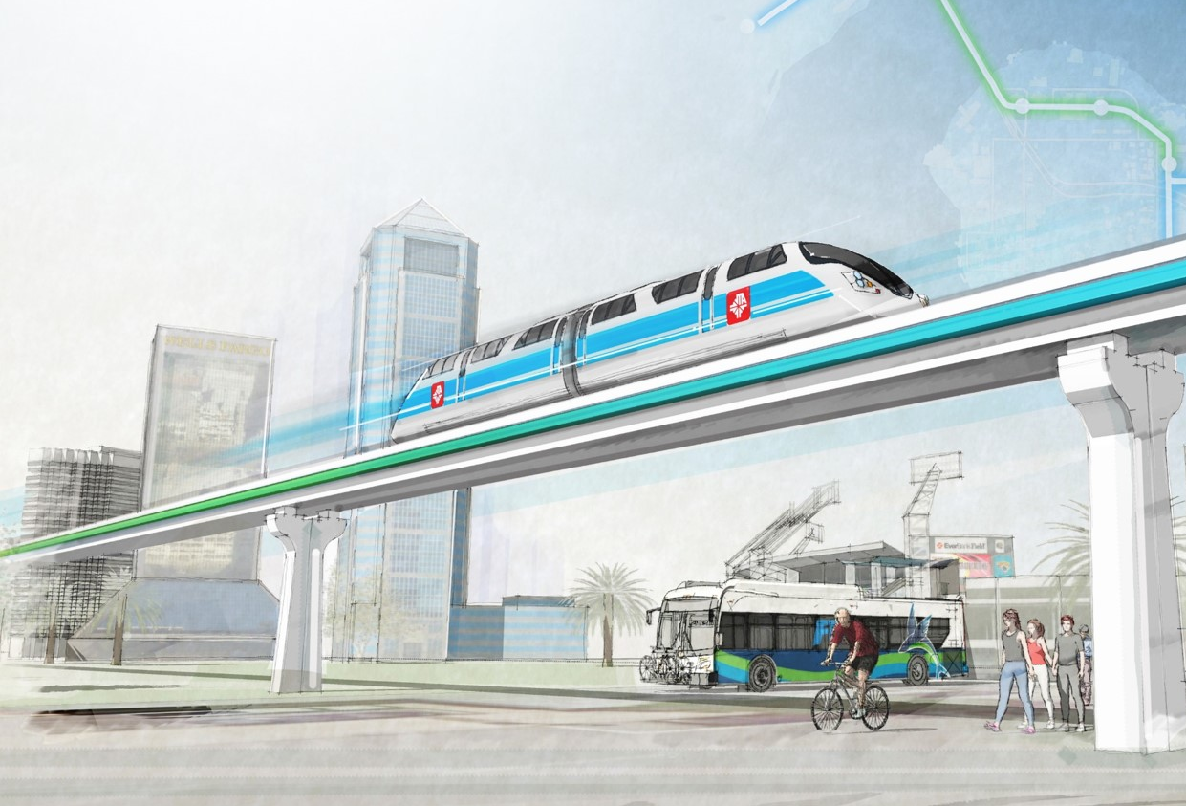
Sustainability Action Plan
Existing conditions and baseline metrics – Solutions memo
Development of a sustainability vision, goals, and a portfolio of projects
Development of an Implementation strategy
“JTA will provide universal access to dynamic, resource-efficient and fiscally responsible transportation and infrastructure solutions that improve quality of life, minimize ecosystem impacts, and enhance economic viability in Northeast Florida.”

Slide 15
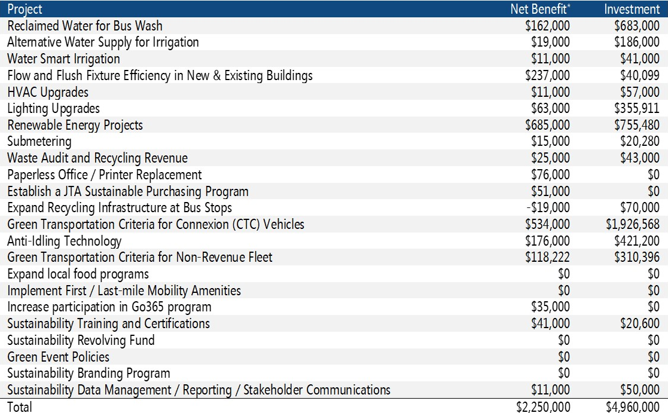
Sustainability Action Plan
Costs & Benefits
$2.3 Million in Net Benefit over 10 years
Environmental Benefits
Save 108 million gallons of water
Save 6.5 million kilowatt-hours of energy
Save 2.9 million gallons of petroleum fuels
Divert 6,850 tons of waste from the landfill
Reduce CAP and avoid 33,000 tons of GHG emissions
Water Use & Pollutant Discharge
Facility Energy Use
Materials Management
Fleet Operations
Healthy Communities
Economic Vitality

Slide 16
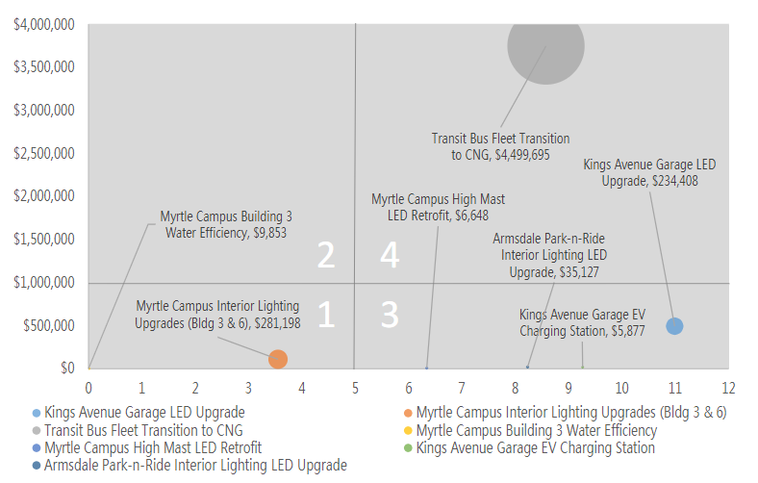
Path Forward
Manage, budget, schedule, and commit
Presenting the financial case
Begin employee education/engagement process – Continuation of workshops
Public Engagement and Annual Updates
Prioritizing “slam dunk” projects

Slide 17
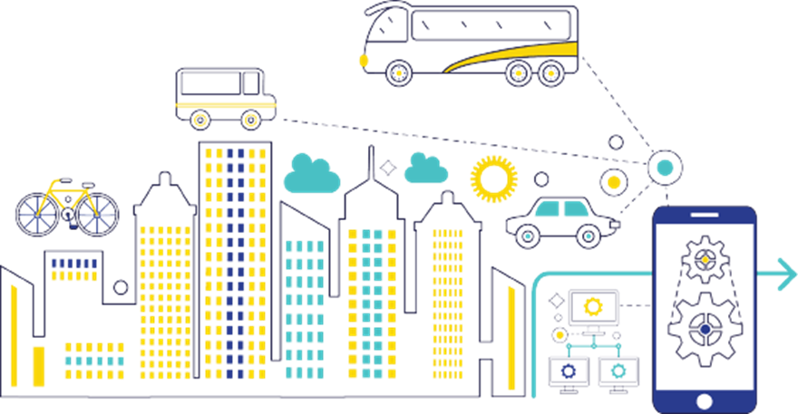
Emerging Trends in Transportation
Mobility as a Service (MaaS)
Microtransit
Autonomous Vehicles
Electrification and Alternative Fuels

Slide 18
Questions?
Alexander Traversa
atraversa@jtafla.com
(904) 632 - 5501

